Slide 1
UK car accidents
Analysis and strategic recommendations

Slide 2
The Team
Panagiota Katsourani
Manthos Foskolos
Orfeas Athanasiou

Slide 3
Who we are
SafeWay Consulting Group,
is a specialized consulting firm focused on data-driven decision making, analytics and strategic planning.
We partner with government agencies to deliver data-driven solutions to complex mobility and infrastructure challenges.
Our mission: To support evidence-based decisions that save lives, improve mobility, and promote sustainable urban development.

Slide 4
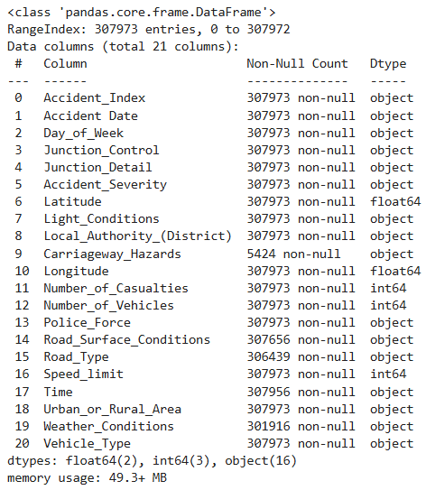
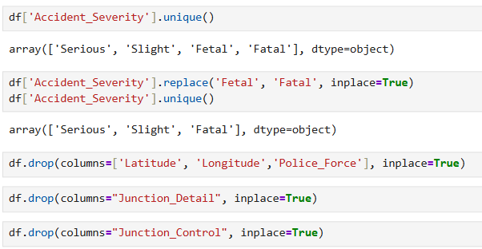
EDA

Slide 5
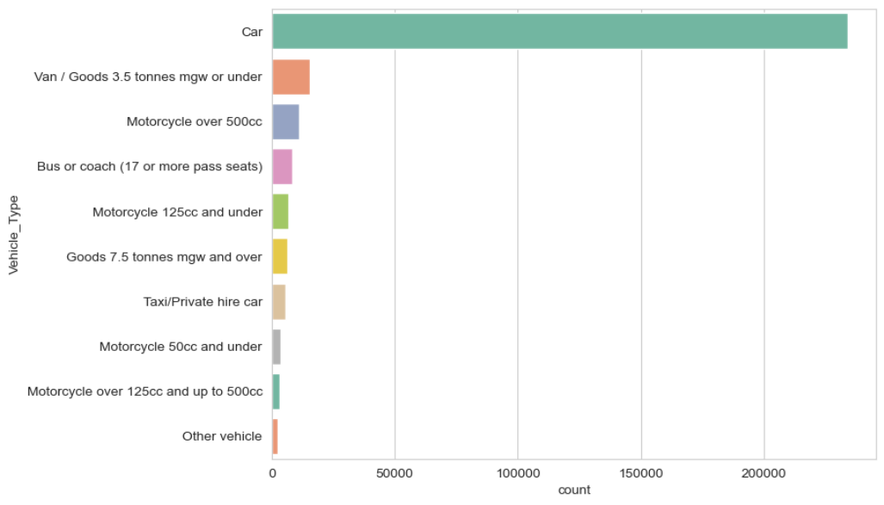
Number of accidents by 'Vehicle Type'

Slide 6
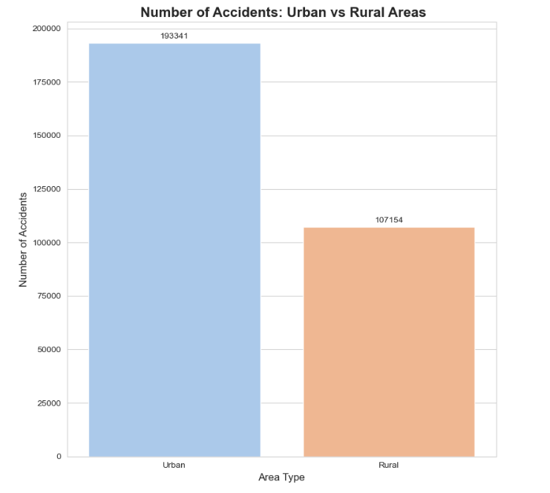
Number of accidents by 'Urban vs Rural Areas'

Slide 7
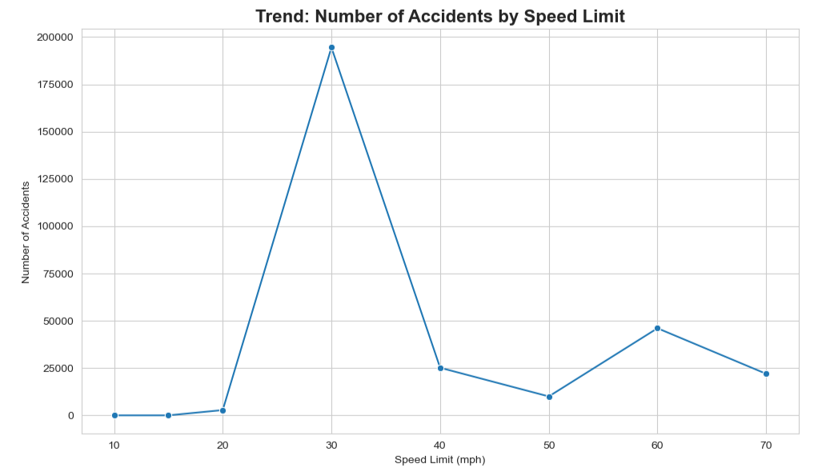
Number of accidents by 'Speed Limit'

Slide 8
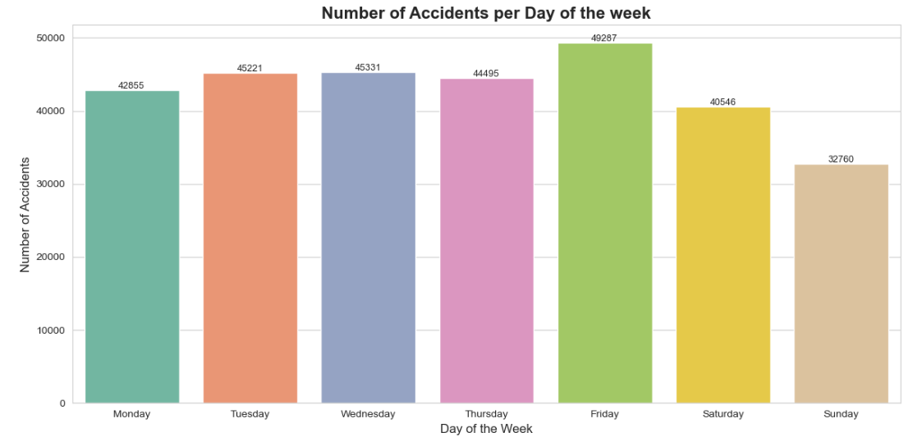
Number of accidents by ‘Day of Week'

Slide 9
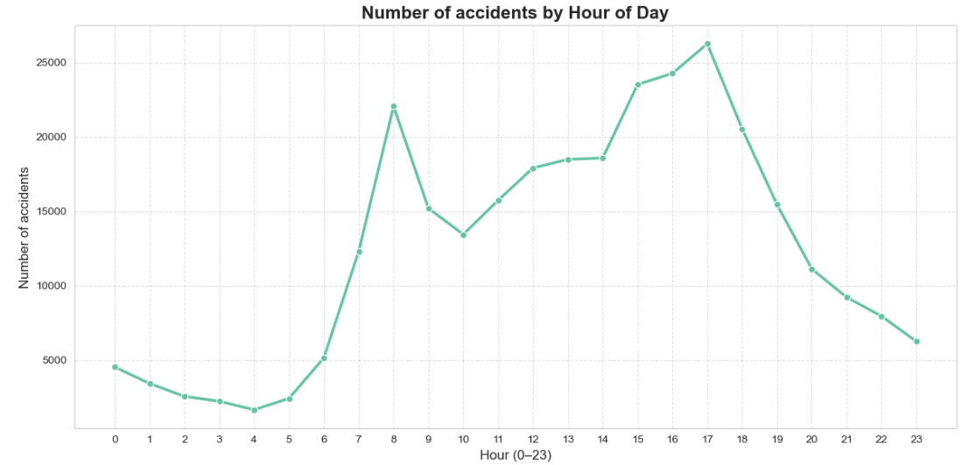
Number of accidents by 'Hour of Day'

Slide 10
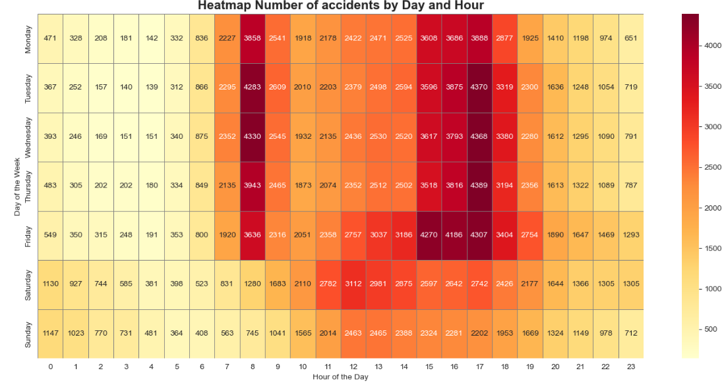
Heatmap - by ‘Day and Hour'

Slide 11
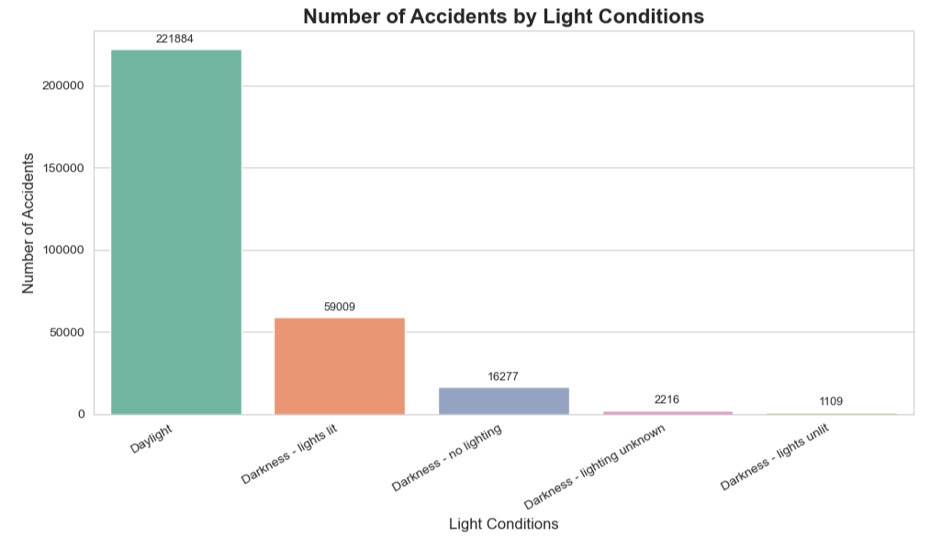
Number of accidents per 'Light Condition'

Slide 12
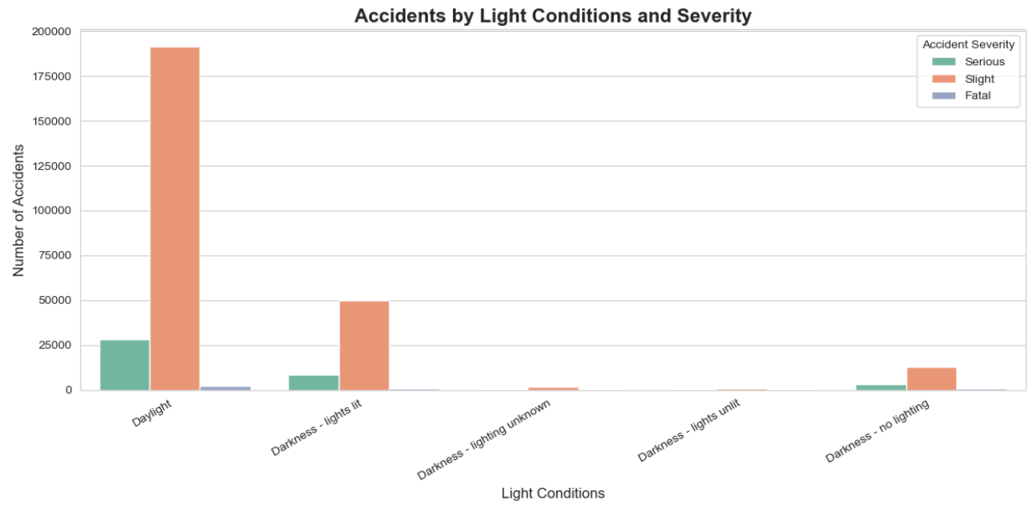
Number of accidents by 'Light Conditions and Severity'

Slide 13
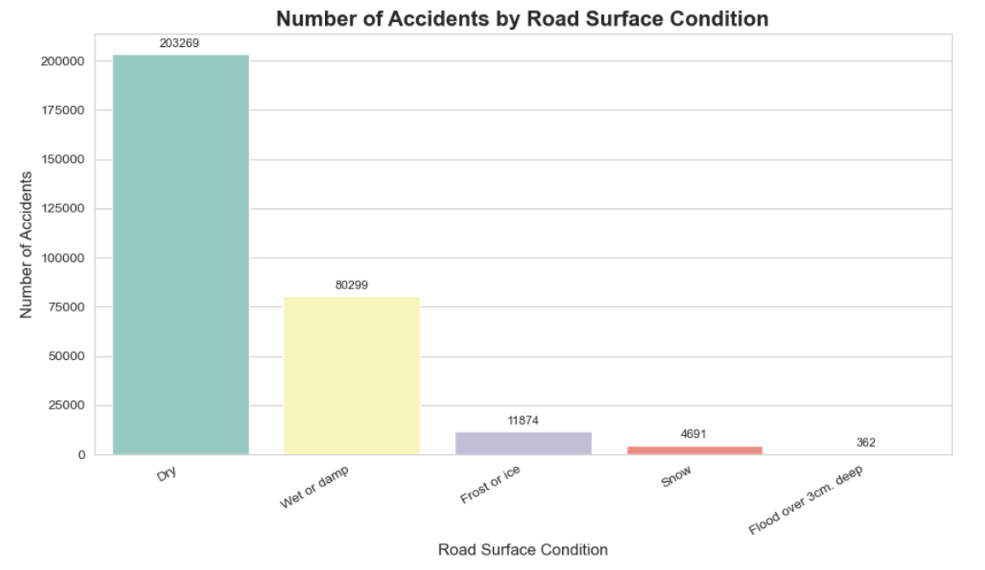
Number of accidents by 'Road Surface Conditions'

Slide 14
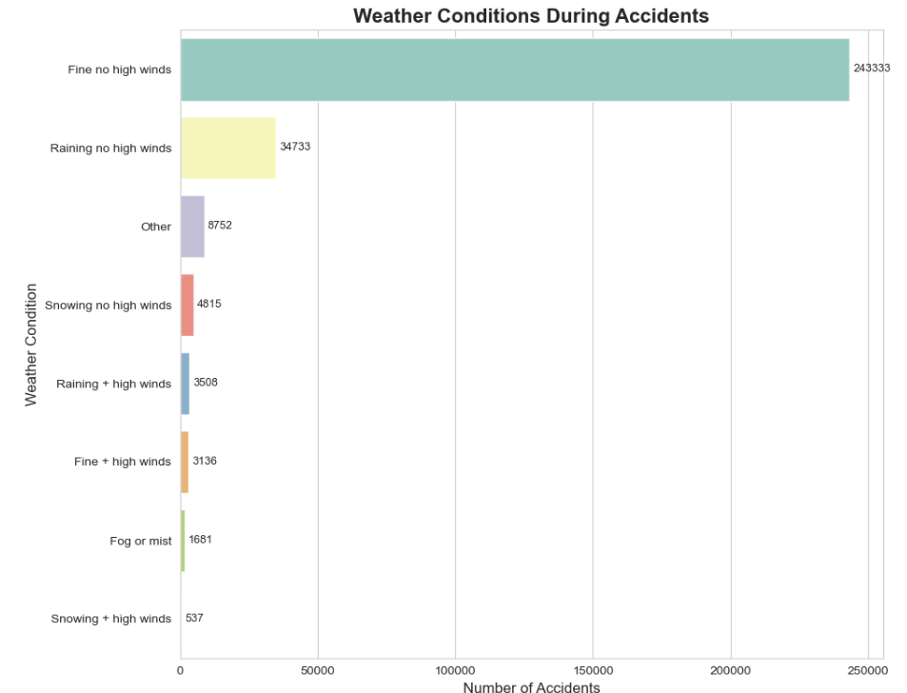
Number of accidents by 'Weather Conditions'

Slide 15
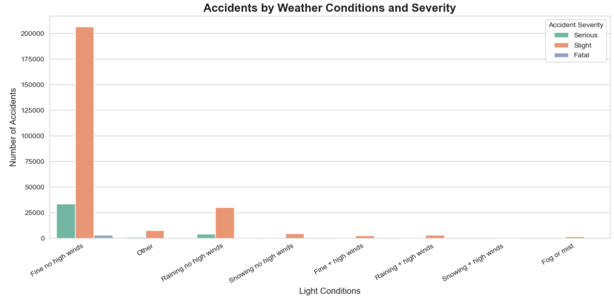
Number of accidents by 'Weather Conditions and Severity'

Slide 16
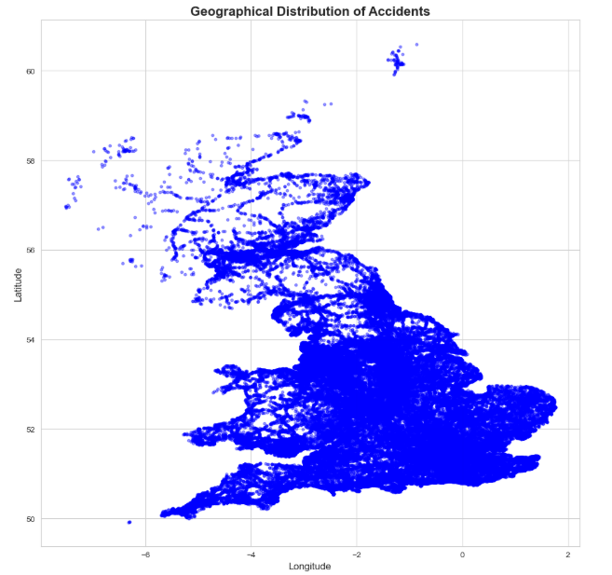
Bonus - Geographical Distribution of Accidents

Slide 17
Conclusions & Recommendations
Launch awareness campaigns to combat driver overconfidence in good weather
Targeted traffic enforcement checks
Incentives for using public transport during peak hours
Motivations to use public transportation during rush hour

